Slide 1

OMIS 670
SOCIAL MEDIA ANALYTICS
PROJECT GUIDE
PROF. ONKAR MALGONDE
by
SAGAR BIRJE
ROHAN MALI
KHUSHAL MOHITE

Slide 2

Skytrax.com
Airline Reviews Data Set
Skytrax.com is an online flight tracking and reviewing website
The data set used for the project is scraped from Skytrax.com
Static Data set
Shout out to Kaggle.com for making the data available
Contains around 14000 records
Reviews are from 2006 to 2019

Slide 3
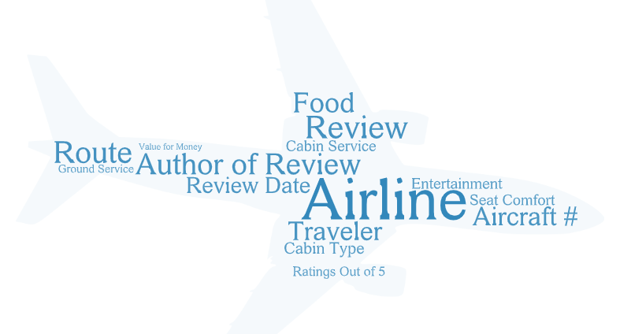
Attributes of the Data Set

Slide 4
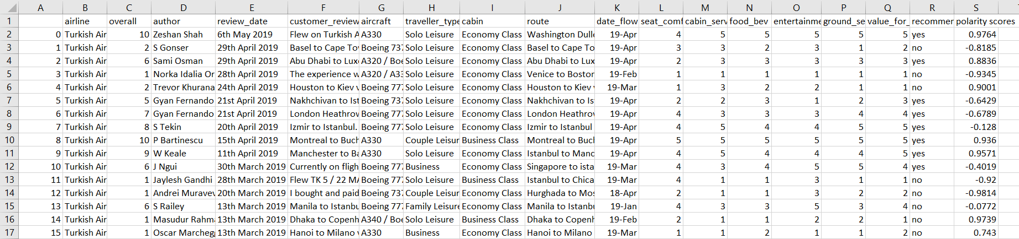
A Look at the Data Set

Slide 5
Analysis Techniques & Tools Used
Topic Modeling
Sentiment Analysis
General Data Visualizations
Python for Topic Modeling and Sentiment Analysis
Tableau & Python for Visualizations

Slide 6
The context of visualization is of Explanatory kind
Our Audience is Airline companies’ management teams
Aim is to apply different analysis techniques on the data and derive meanings that will act as a basis for any business decisions taken
Develop strategies to attract more customers and extend market reach

Slide 7
Topic Modeling
Performed using Python and Gensim package is used
LDA algorithm inbuilt in the package is used
Topic Model visualized using pyLDAvis
4 topics are computed with 10 keywords weighted in each topic
Top 30 most salient terms are considered from the entire corpus and then term frequency is displayed for individual topics using visualizations

Slide 8
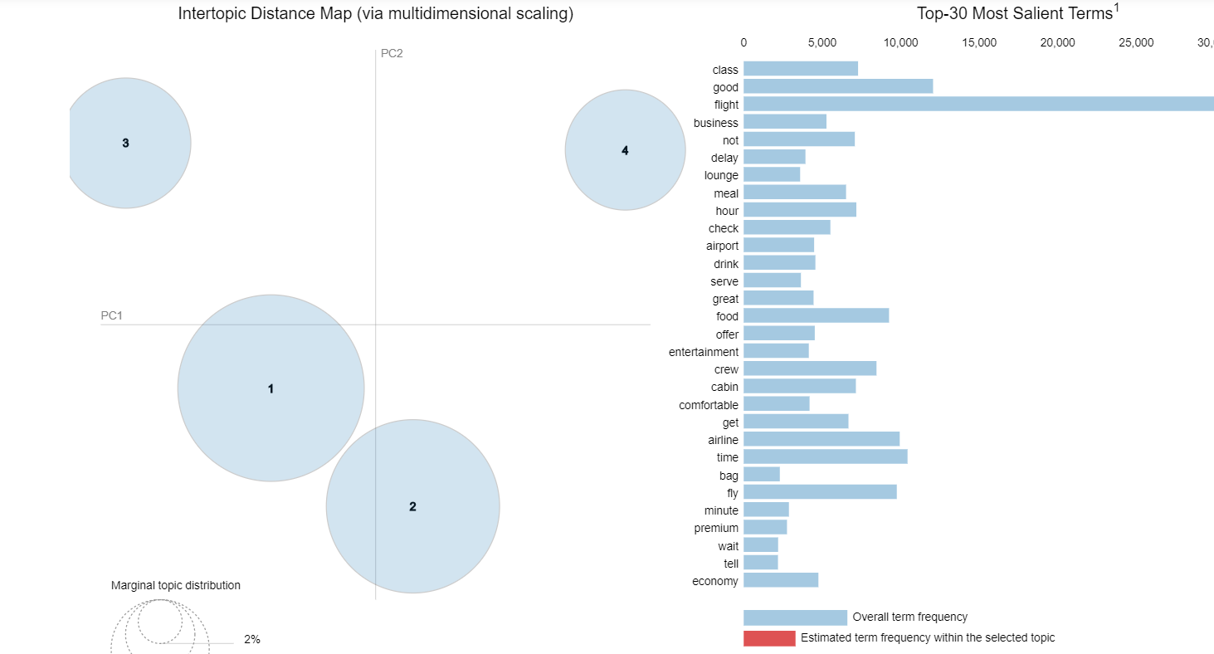
Overall term frequency

Slide 9
Topic 1
In topic 1, the word “seat” has the prevalence with around 9000 occurrences
36.1 % of overall tokens are present in topic 1
Around 3000 occurrences of word “bad”
Other words like bad, pay, Norwegian etc. have higher frequencies
This suggests that topic 1 is about negative reviews about Norwegian Airlines

Slide 10
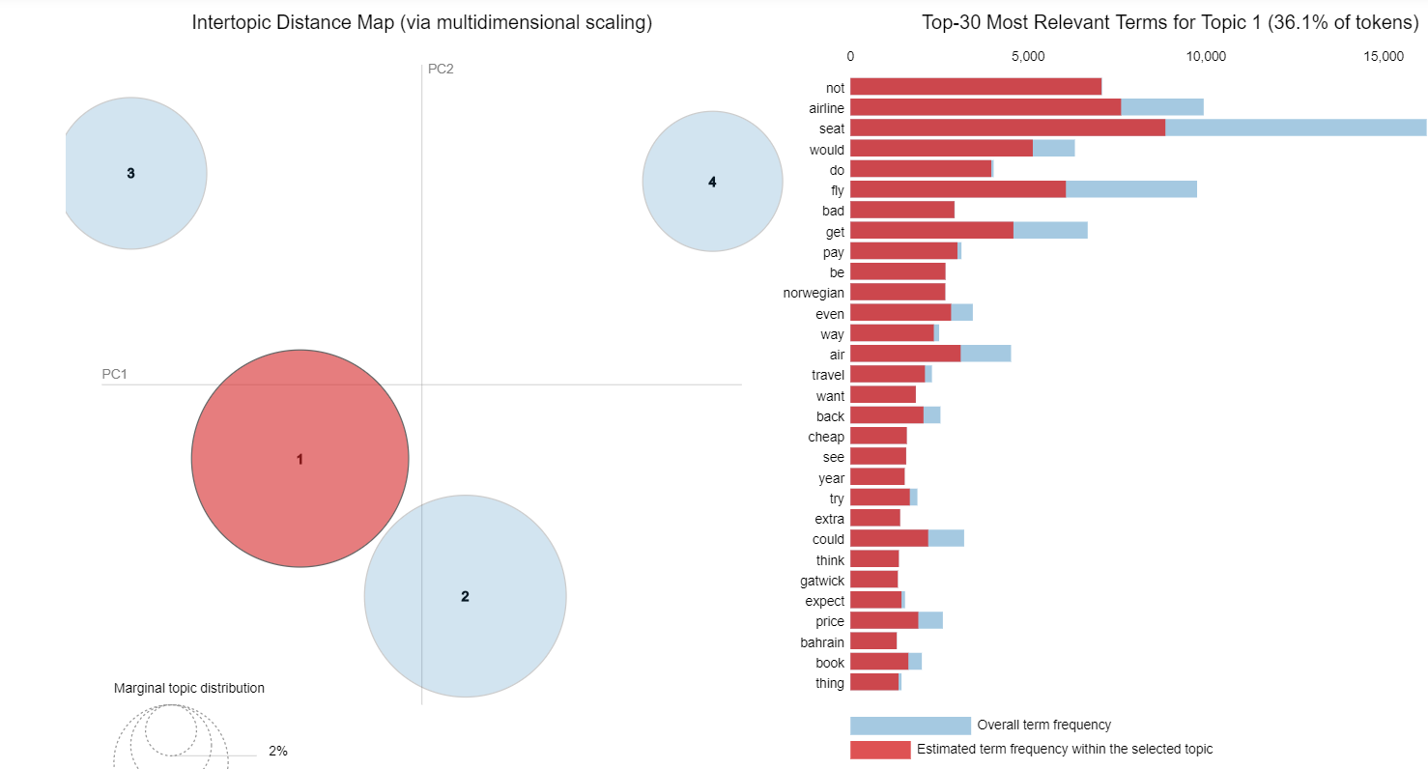
Topic 1

Slide 11
Topic 2
In topic 2, the word “good” has the prevalence with around 12000 occurrences
31.2 % of overall tokens are present in topic 2
Around 4000 occurrences of word “great”
Other words like food, crew, cabin, comfortable etc. have higher frequencies
This suggests that topic 2 is about positive reviews about a particular Airline

Slide 12
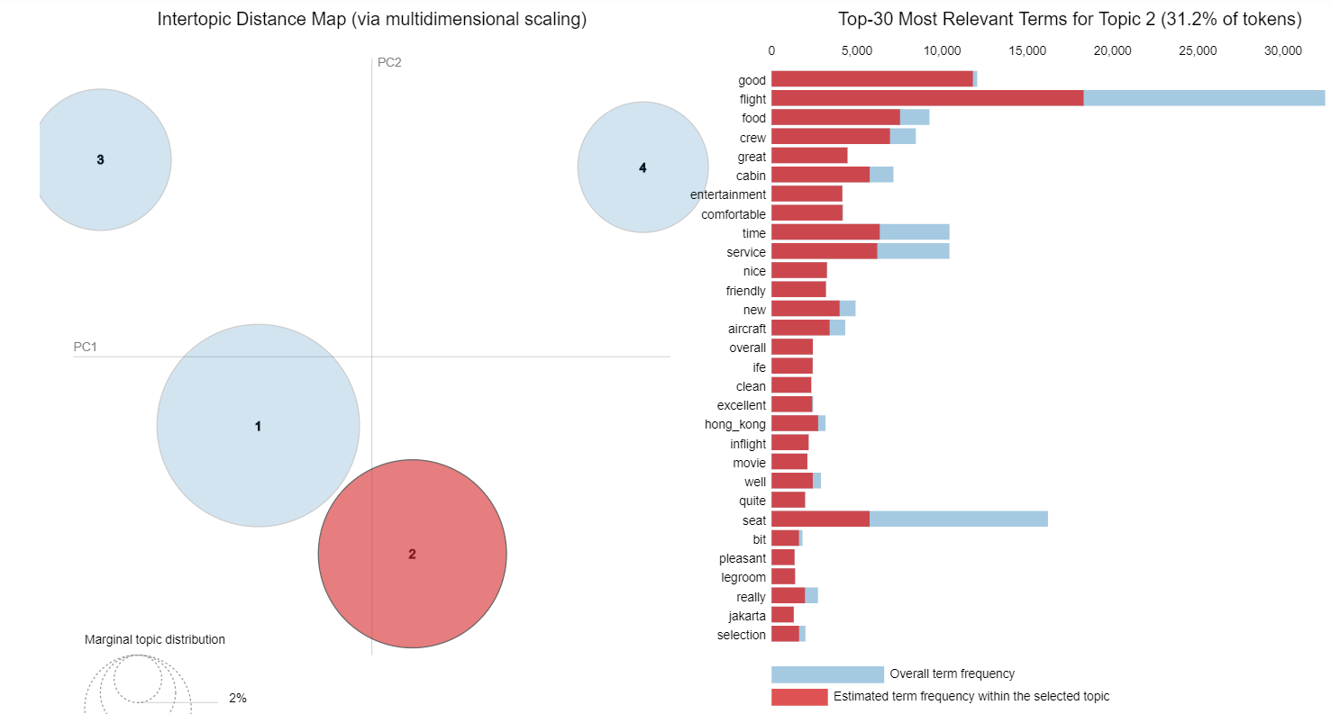
Topic 2

Slide 13
Topic 3
In topic 3, the word “hour” has the prevalence with around 5000 occurrences
17.6 % of overall tokens are present in topic 3
Around 4000 occurrences of word “delay”
Other words like check, wait, late, due etc. have higher frequencies
This suggests that topic 3 is a complaint review about a particular Airline, like the flight might have delayed a lot hence disappointing the reviewer/customer

Slide 14
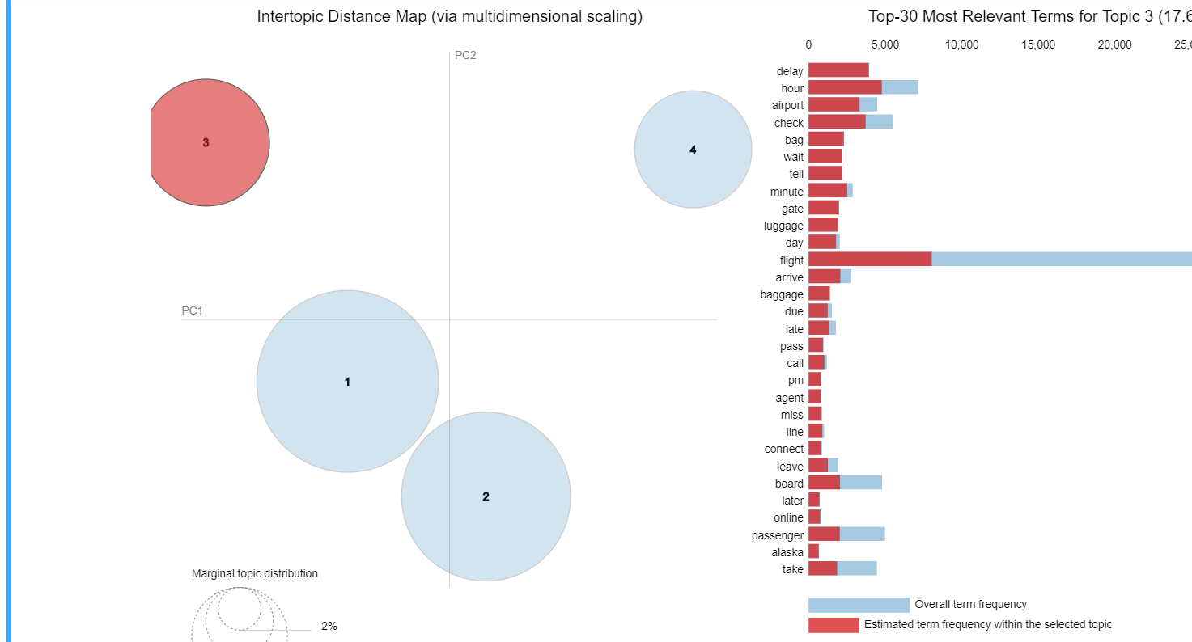
Topic 3

Slide 15
Topic 4
In topic 4, the word “class” and “business” have the highest prevalence
15 % of overall tokens are present in topic 4
more than 3000 occurrences of word “meal”
Other words like drink, breakfast, dinner, lunch, juice etc. have higher frequencies
This suggests that topic 4 is about maybe positive review about the food and other services at cathay Airline

Slide 16
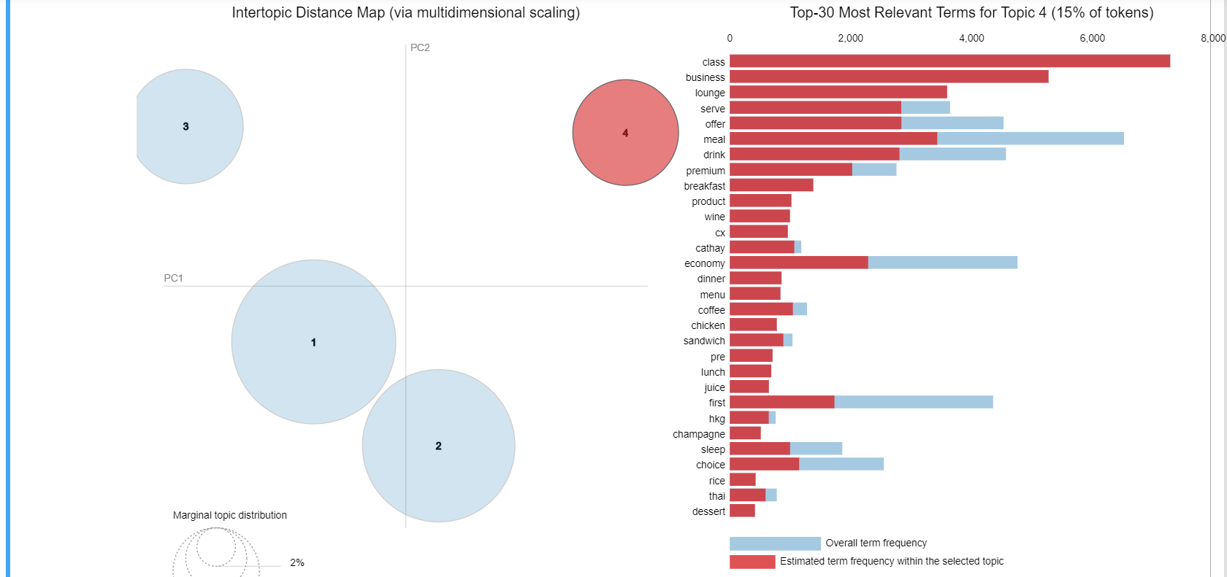
Topic 4

Slide 17
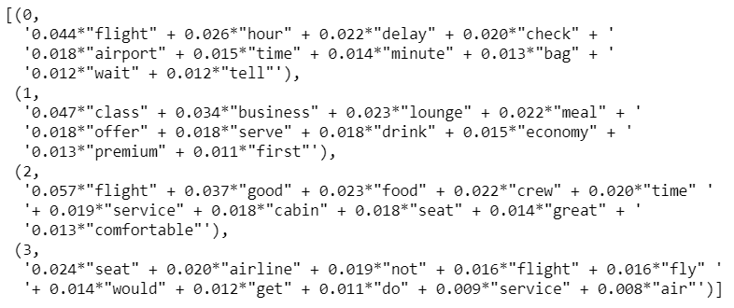
Computed results of the
model with terms and their weights

Slide 18
Metrics for the Model
Perplexity : -7.2157…
Perplexity tells how good the model is. Lower the better.
Negative suggests that the model is quite good.
Coherence Score: 0.4025…
Suggests the coherency of the topics and 0.40 is quite good.

Slide 19
Sentiment Analysis
Performed using Python and Vader package is used
Polarity scores are calculated for all the reviews
Scores below 0 are labelled negative (<0)
Scores between 0 to 0.5 as Neutral (0 <= i <=0.5)
Scores that are above 0.5 are labelled as Positive (>0.5)

Slide 20
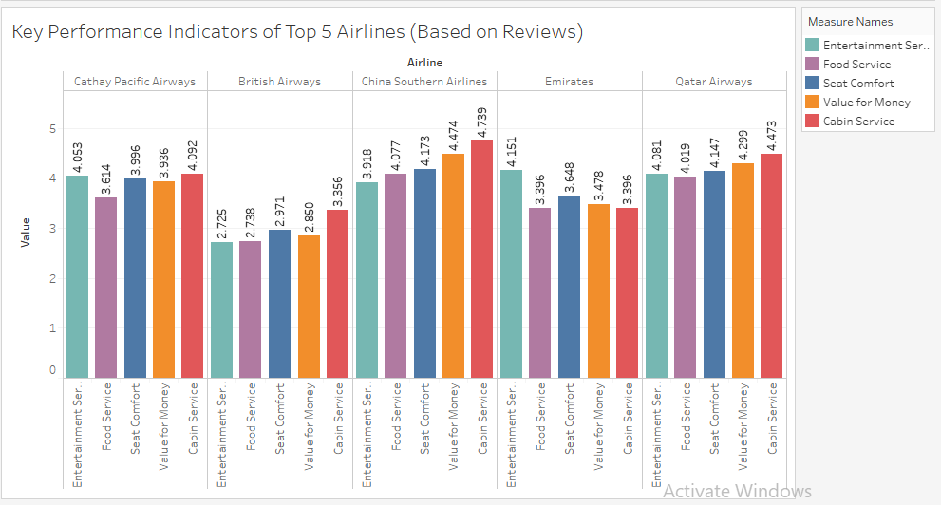

Slide 21
Inference and Recommendation
What are the top rated features of the best 5 Airlines?
(Assuming the KPI's of factors whose average rating typically falls between 3-5 on the scale of 5)
China Southern Airline has the highest Average of all 5 Factors which is 4.27 on the scale of 5.
Whereas British Airways had the least average of all 5 factors which is 2.96 on the scale of 5. We performed this visualization first by calculating the Top 5 airlines based on their sentiment scores.
Then we performed the Average on the 5 factors on these top 5 airlines.
British airways needs complete revamp in its strategy since it has been rated least on all 5 factors of Seat Comfort, Cabin Service, Food & Beverages Service, Entertainment, Ground Service.
The companies can use superior strategy to improve the quality ratings which are less. For Ex. British Airways and Emirates can learn what areas need improvement and how they differ in terms of service from China Southern Airline or Qatar Airways.

Slide 22
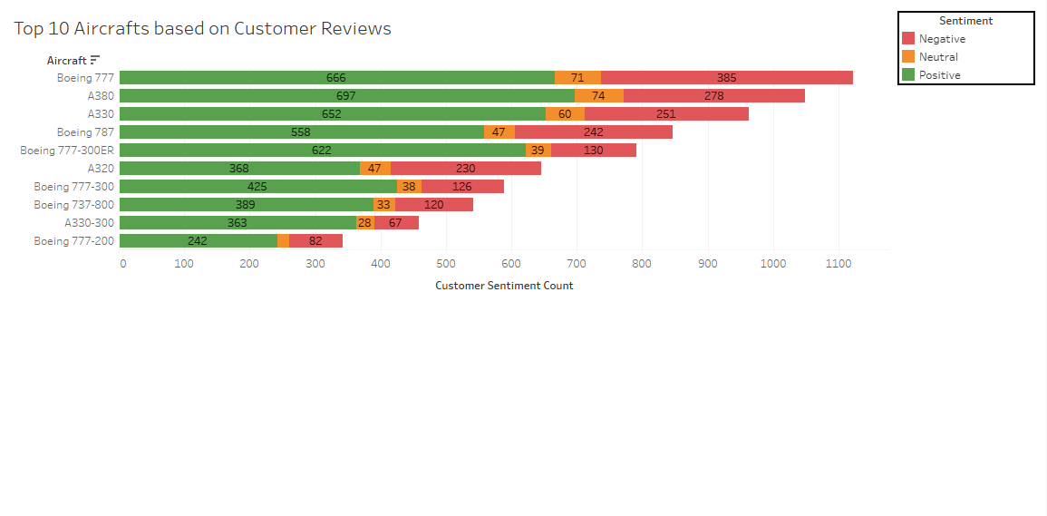

Slide 23
Inference and Recommendation
What type of aircraft is the best for customer satisfaction according to reviews?
Boeing 777 and Airbus A380 are the top rated aircrafts in terms of positive reviews. We performed this visualization by counting the sentiment scores for top 10 airlines based on positive, neutral or Negative reviews.
Different aircrafts come with different specifications, extra space, high tech features, varied fuel consumption.
Hence from this visualization we can recommend top airline companies to buy more Airbus A380 and Boeing 777 aircraft for increased customer satisfaction.
Also the aircrafts which are rated the least should not be used and replaced with better ones.
Buying one larger plane to transit people on the most popular route is the most efficient way instead of using small aircrafts twice. This will cut extra costs and increase profits.

Slide 24
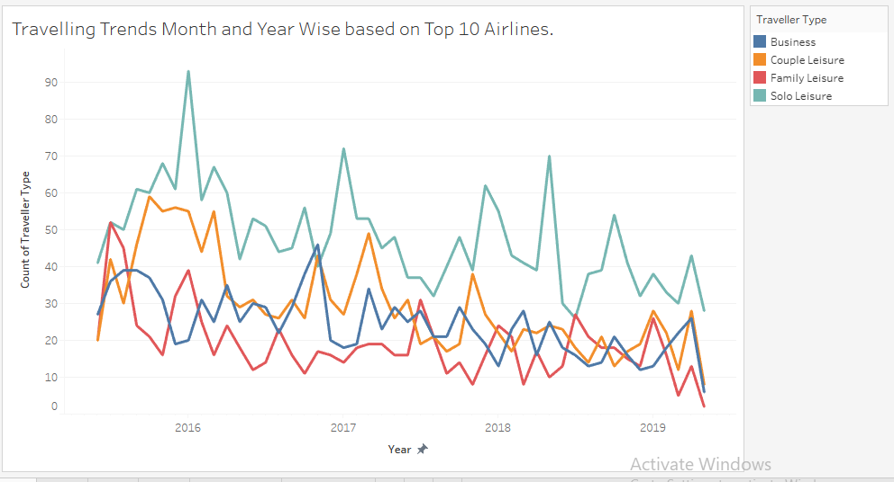

Slide 25
Inference and Recommendation
Which type of traveler type among the top 10 Airlines have travelled the most in the 4 year period?
People preferred travelling solo leisure. People travelled less in Family Leisure.We performed this visualization by counting the sentiment scores for top 10 airlines and counting the traveller type for the four year period.
People travelling solo can account for less occupancy for the flight which can in turn incur losses to the airline. When more people will travel through a family leisure this will increase the number of people travelling on the route thus increasing the occupancy of the route and this keep the route to stay for many years and incur less losses to company.
Hence discounts should be introduced by top airlines on customers travelling with family to attract more new customers.
Also introduction of group discount plans will encourage more people to fly with the airline.

Slide 26
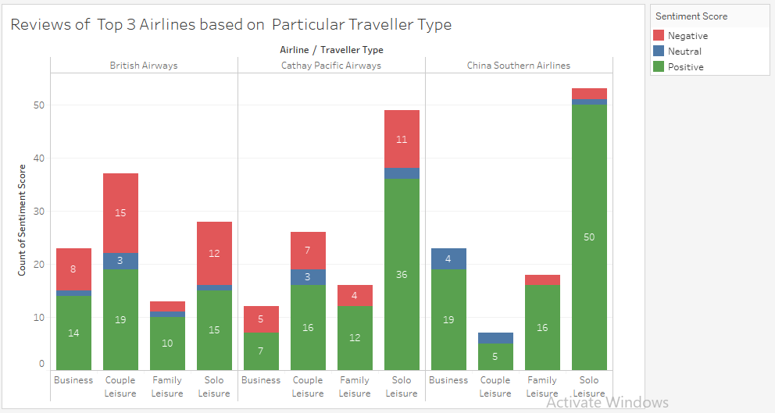

Slide 27
Inference and Recommendation
What is the sentiment of particular traveler type towards rating the Top 3 airlines?
Solo Travelers make up the largest type of travelers rating the Airlines. We performed this visualization by counting the sentiment score of travelers of all types. The sentiment is calculated on the Basis of positive, negative and Neutral. From this visualization we can infer that Solo Travelers have given maximum positive reviews for Cathay Pacific Airlines and China Southern Airlines. Whereas British Airways has least no. of reviews from Solo Travelers.
The drastic drop in the couple leisure on china southern airlines indicate that the airline has had very few couples travelling on the airline. Steps should be taken by the airline to introduce more couple discount packages for bookings and retrospect as to what improvements can be done.

Slide 28
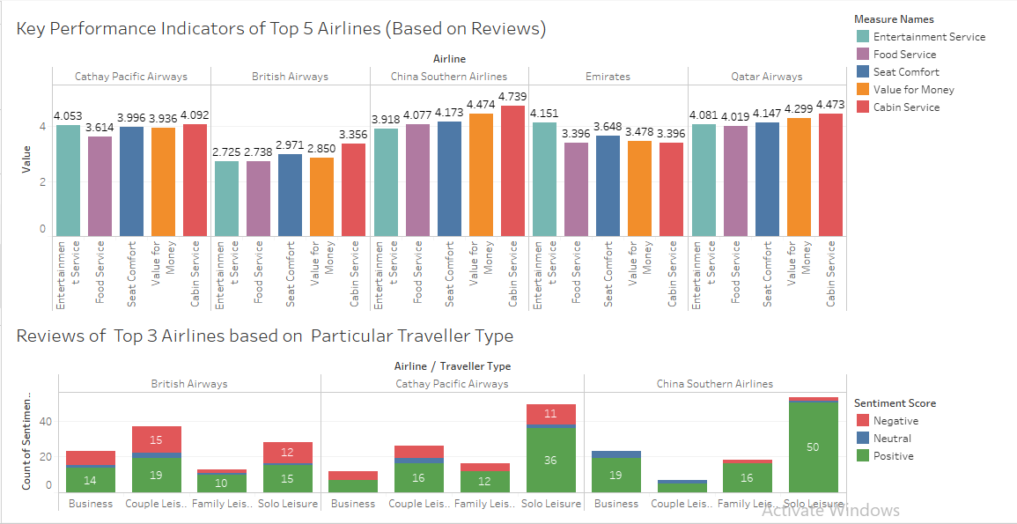
Dashboards

Slide 29
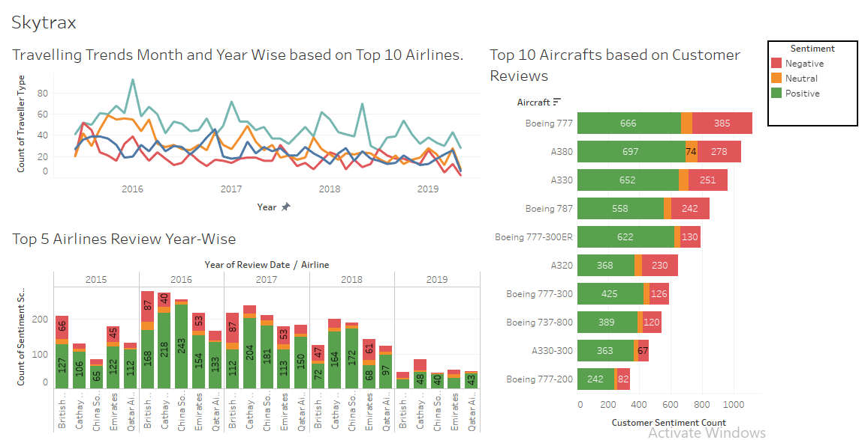

Slide 30
THANK YOU

